Slide 1

CISC360 Computer Architecture
Lesson 15
Interconnection Networks

Slide 2
Networks
Goal: Communication between computers
Eventual Goal: treat collection of computers as if one big computer, distributed resource sharing
Theme: Different computers must agree on many things
  Overriding importance of standards and protocols
  Fault tolerance critical as well
Warning: Terminology-rich environment
Notes:
Obvious goal
1 big coherent file system as future goal?
Standards critical

Slide 3
Networks
Facets people talk a lot about:
  direct (point-to-point) vs. indirect (multi-hop)
  topology (e.g., bus, ring, star)
  routing algorithms
  switching (aka multiplexing)
  wiring (e.g., choice of media, copper, coax, fiber)
What really matters:
  latency
  bandwidth
  cost
  reliability

Slide 4

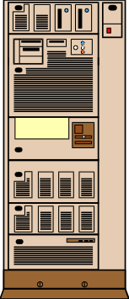
Interconnections (Networks)
Examples:
  MPP networks (SP2): 100s nodes; ~ 25 meters per link
  Local Area Networks (Ethernet): 100s nodes; ~ 1000 meters
  Wide Area Network (ATM): 1000s nodes; ~ 5,000,000 meters
a.k.a.
end systems,
hosts
Interfaces
H/W
S/W
a.k.a.
network,
communication
subnet
Interconnection Network

Slide 5
More Network Background
Connection of 2 or more networks: Internetworking
3 cultures for 3 classes of networks
  MPP: performance, latency and bandwidth
  LAN: workstations, cost
  WAN: telecommunications, phone call revenue
Try for single terminology

Slide 6
ABCs of Networks
Starting Point: Send bits between 2 computers
Queue (FIFO) on each end
Information sent called a “message”
Can send both ways (“Full Duplex”)
Rules for communication? “protocol”
  Inside a computer:
    Loads/Stores: Request (Address) & Response (Data)
    Need Request & Response signaling

Slide 7
A Simple Example
What is the format of message?
  Fixed? Number bytes?
Request/
Response
Address/Data
1 bit
32 bits
0: Please send data from Address
1: Packet contains data corresponding to request
Header/Trailer: information to deliver a message
Payload: data in message (1 word above)

Slide 8
Questions About Simple Example
What if more than 2 computers want to communicate?
  Need computer “address field” (destination) in packet
What if packet is garbled in transit?
  Add “error detection field” in packet (e.g., CRC)
What if packet is lost?
  More “elaborate protocols” to detect loss
  (e.g., NAK, ARQ, time outs)
What if multiple processes/machine?
  Queue per process to provide protection
Simple questions such as these lead to more complex protocols and packet formats => complexity

Slide 9
A Simple Example Revisited
What is the format of packet?
  Fixed? Number bytes?
Request/
Response
Address/Data
CRC
1 bit
32 bits
4 bits
00: Request—Please send data from Address
01: Reply—Packet contains data corresponding to request
10: Acknowledge request
11: Acknowledge reply

Slide 10
Software to Send and Receive
SW Send steps
  1: Application copies data to OS buffer
  2: OS calculates checksum, starts timer
  3: OS sends data to network interface HW and says start
SW Receive steps
  3: OS copies data from network interface HW to OS buffer
  2: OS calculates checksum, if matches send ACK; if not, deletes message (sender resends when timer expires)
  1: If OK, OS copies data to user address space and signals application to continue
Sequence of steps for SW: protocol
  Example similar to UDP/IP protocol in UNIX

Slide 11
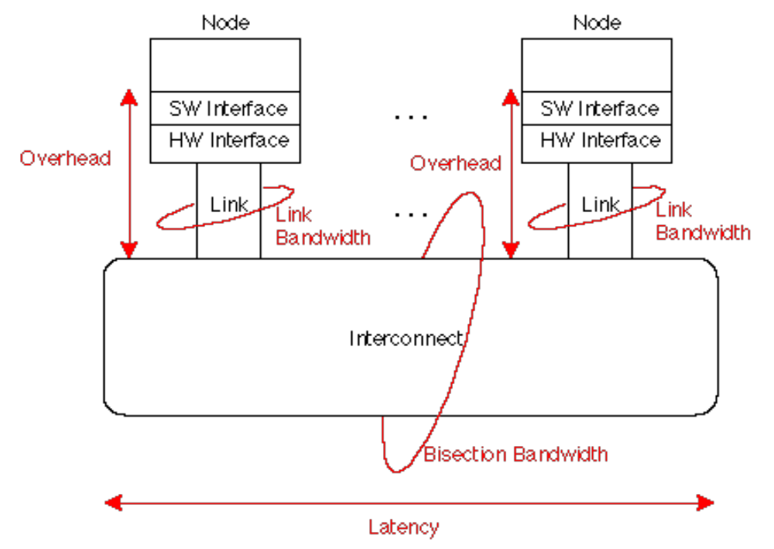
Network Performance Measures
Overhead: latency of interface vs. Latency: network
Notes:
Link bandwidth: 10 Mbit Ethernet
What is interconnet BW?
bus => link speed
switch => 100 * link speed
What gets quoted? link BW?
What is latency? Interconnect?

Slide 12
Universal Performance Metrics
Sender
Overhead
Transmission time
(size ÷ bandwidth)
Sender
(processor
busy)
Time of
Flight
Transmission time
(size ÷ bandwidth)
Receiver
Overhead
Receiver
Transport Latency
(processor
busy)
Total Latency
Total Latency = Sender Overhead + Time of Flight +
Message Size ÷ BW + Receiver Overhead
Includes header/trailer in BW calculation?
Notes:
Easy to get these things confused! Colors should help
Min (link BW, bisection BW)
Assumes no congestion
Receiver usually longer
Better to send then receive
Store Like send
Read like Receive

Slide 13
Example Performance Measures
Interconnect MPP LAN WAN
Example CM-5 Ethernet ATM
Bisection BW N x 5 MB/s 1.125 MB/s N x 10 MB/s
Int./Link BW 20 MB/s 1.125 MB/s 10 MB/s
Transport Latency 5 µsec 15 µsec 50 to 10,000 µs
HW Overhead to/from 0.5/0.5 µs 6/6 µs 6/6 µs
SW Overhead to/from 1.6/12.4 µs 200/241 µs 207/360 µs (TCP/IP on LAN/WAN)
Software overhead dominates in LAN, WAN

Slide 14
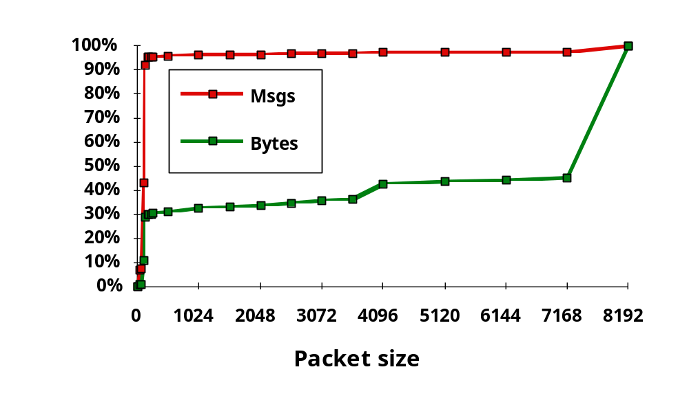
Measurement:
Sizes of Message for NFS
Why?
95% Msgs, 30% bytes for packets < 200 bytes
> 50% data transferred in packets = 8KB

Slide 15
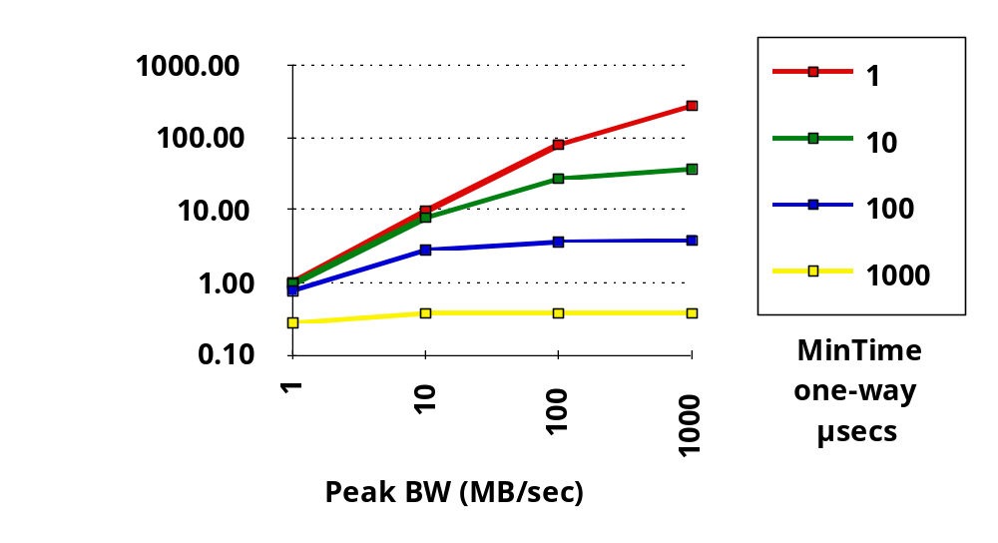
Impact of Overhead on Delivered BW
BW model: Time = overhead + msg size/peak BW
> 50% data transferred in packets = 8KB

Slide 16
Interconnect Issues
Performance Measures
Interface Issues

Slide 17
HW Interface Issues
Where to connect network to computer?
  Cache consistent to avoid flushes? (=> memory bus)
  Latency and bandwidth? (=> memory bus)
  Standard interface card? (=> I/O bus)
  MPP => memory bus; LAN, WAN => I/O bus
CPU
Network
Network
$
ideal: high bandwidth,
low latency,
standard interface
I/O
I/O
L2 $
Controller
Controller
Memory Bus
I/O bus
Memory
Bus Adapter

Slide 18
SW Interface Issues
How to connect network to software?
  Programmed I/O?(low latency)
  DMA? (best for large messages)
  Receiver interrupted or received polls?
Things to avoid
  Invoking operating system in common case
  Operating at un-cached memory speed
  (e.g., check status of network interface)

Slide 19
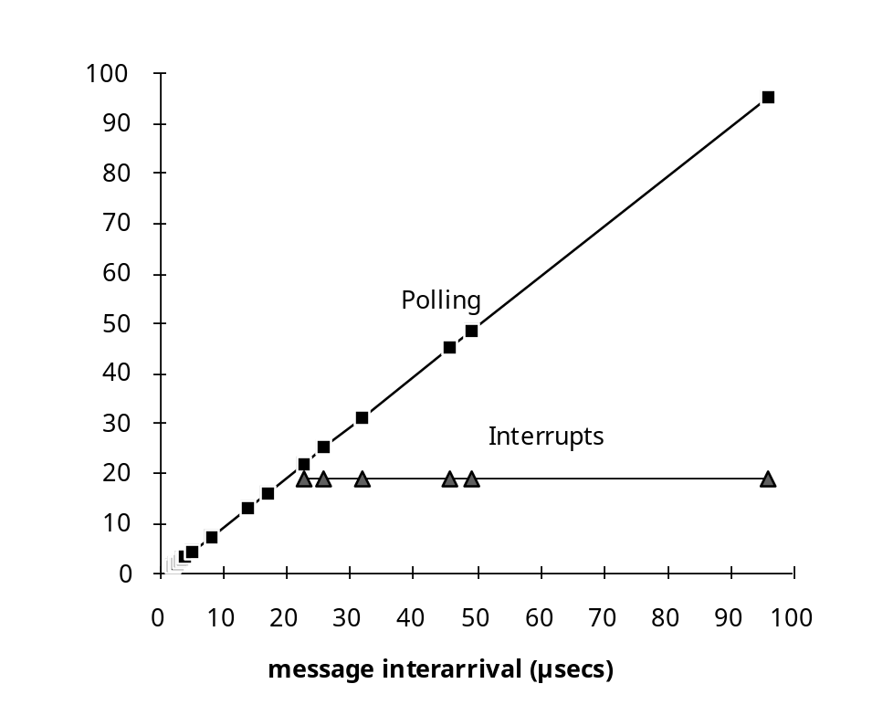
CM-5 Software Interface
Overhead
CM-5 example (MPP)
  Time per poll 1.6 µsecs; time per interrupt 19 µsecs
  Minimum time to handle message: 0.5 µsecs
  Enable/disable 4.9/3.8 µsecs
As rate of messages arriving changes, use polling or interrupt?
  Solution: Always enable interrupts, have interrupt routine poll until until no messages pending
  Low rate => ­ interrupt
  High rate => ­ polling
Time between messages

Slide 20
Interconnect Issues
Performance Measures
Interface Issues
Network Media

Slide 21
Network Media
Twisted Pair:
Copper, 1mm think, twisted to avoid
antenna effect (telephone)
Coaxial Cable:
Plastic Covering
Used by cable companies: high BW, good noise immunity
Braided outer conductor
Insulator
Copper core
Light: 3 parts are cable, light source, light detector.
Multimode light disperse (LED), Single mode single wave (laser)
Fiber Optics
Total internal
Transmitter
Air
reflection
Receiver
– L.E.D
– Photodiode
– Laser Diode
light
source
Silica

Slide 22
Interconnect Issues
Performance Measures
Interface Issues
Network Media
Connecting Multiple Computers

Slide 23
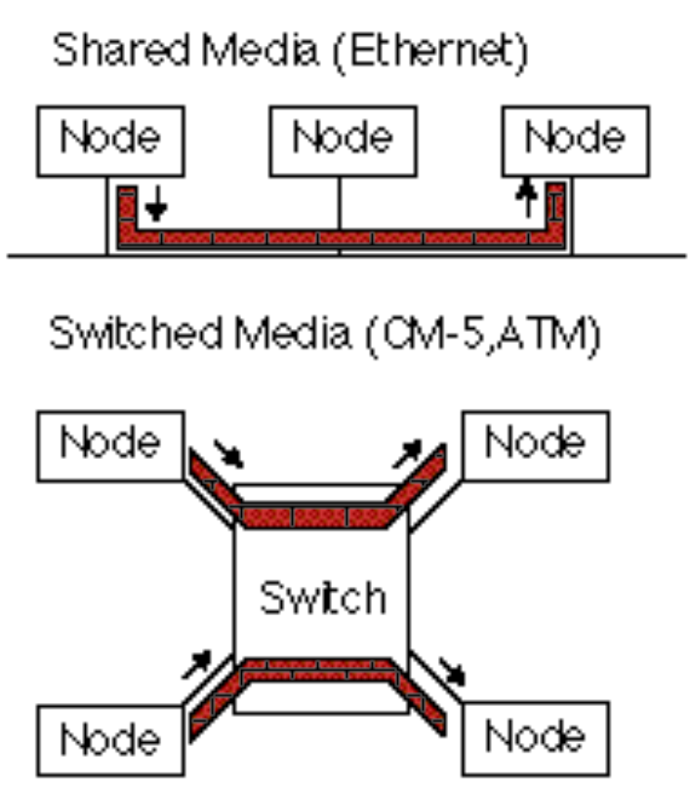
Connecting Multiple Computers
Shared Media vs. Switched: pairs communicate at same time: “point-to-point” connections
Aggregate BW in switched network is many times shared
  point-to-point faster since no arbitration, simpler interface
Arbitration in Shared network?
  Central arbiter for LAN?
  Listen to check if being used (“Carrier Sensing”)
  Listen to check if collision
  (“Collision Detection”)
  Random resend to avoid repeated collisions; not fair arbitration;
  OK if low utilization
(A. K. A. data switching
interchanges, multistage
interconnection networks,
interface message processors)

Slide 24
Switch Topology
Structure of the interconnect
Determines
  Degree: number of links from a node
  Diameter: max number of links crossed between nodes
  Average distance: number of hops to random destination
Warning: these three-dimensional drawings must be mapped onto chips and boards which are essentially two-dimensional media
  Elegant when sketched on the blackboard may look awkward when constructed from chips, cables, boards, and boxes (largely 2D)
Networks should not be interesting!

Slide 25
Example MPP Networks
Name Number Topology Bits Clock Link Year
nCube/ten 1-1024 10-cube 1 10 MHz 1.2 1987
iPSC/2 16-128 7-cube 1 16 MHz 2 1988
MP-1216 32-512 2D grid 1 25 MHz 3 1989
Delta 540 2D grid 16 40 MHz 40 1991
CM-5 32-2048 fat tree 4 40 MHz 20 1991
CS-2 32-1024 fat tree 8 70 MHz 50 1992
Paragon 4-1024 2D grid 16 100 MHz 200 1992
T3D 16-1024 3D Torus 16 150 MHz 300 1993
No standard MPP topology!
MBytes/second

Slide 26
Summary: Interconnections
Packets for standards, protocols to cover normal and abnormal events
Performance issues: HW & SW overhead, interconnect latency,
Media sets cost, distance
Shared vs. Switched Media determines BW
HW and SW Interface to computer affects overhead, latency, bandwidth
Topologies: many to chose from, but (SW) overheads make them look alike; cost issues in topologies, not algorithms

